Slide 1
A language learning tool - Eng2AlbSL (English to Albanian Sign Language)
Polytechnic University of Tirana
Faculty of Information Technology
Hari Dimoshi, Fatjon Sakiqi, Besjana Muraku
13th Workshop “SEE&RE”
Bansko, BULGARIA 26-31 August 2013

Slide 2
CONTENTS
Introduction
Why Hearing Impaired People?
Why Albanian Sign Language?
Why English?
Application
Reception
For the future
Conclusions

Slide 3
CONTENTS
Introduction
Why Hearing Impaired People?
Why Albanian Sign Language?
Why English?
Application
Reception
For the future
Conclusions

Slide 4
Introduction
Microsoft Imagine Cup 2013 National Contest
Make a software application with the potential to make a positive contribution to the betterment of society.
Usage of Microsoft technologies and products

Slide 5
Introduction (2)
Build a language learning software, targeting people with hearing imparities.
Native Language: Albanian Sign Language
Foreign Language: Written English
Case Scenarios:
English to Albanian Sign Language
Albanian Sign Language to English

Slide 6
CONTENTS
Introduction
Why Hearing Impaired People?
Why Albanian Sign Language?
Why English?
Application
Reception
For the future
Conclusions

Slide 7
Why Hearing Impaired People?
Opportunities
They have skills, talent, and knowledge.
They can and want to attend college and work.
Community
Hearing impaired community in Albania : 207’000 .
Insufficientsupport from society and government.
Difficulties
They have difficulty in developing satisfactory language skills.
[1]
[1] Karin Hoyer, 2007. "Albanian Sign Language: Language Contact, International Sign and Gesture”.

Slide 8
CONTENTS
Introduction
Why Hearing Impaired People?
Why Albanian Sign Language?
Why English?
Application
Reception
For the future
Conclusions

Slide 9
Why Albanian Sign Language?
There is no International Sign Language
Every culture has its own sign language and language of signs
In most cases it’s the first language to be learned as a child
Written language is a secondary language
Albanian Sign Language is relatively well studied compared to most sign languages

Slide 10
CONTENTS
Introduction
Why Hearing Impaired People?
Why Albanian Sign Language?
Why English?
Application
Reception
For the future
Conclusions

Slide 11
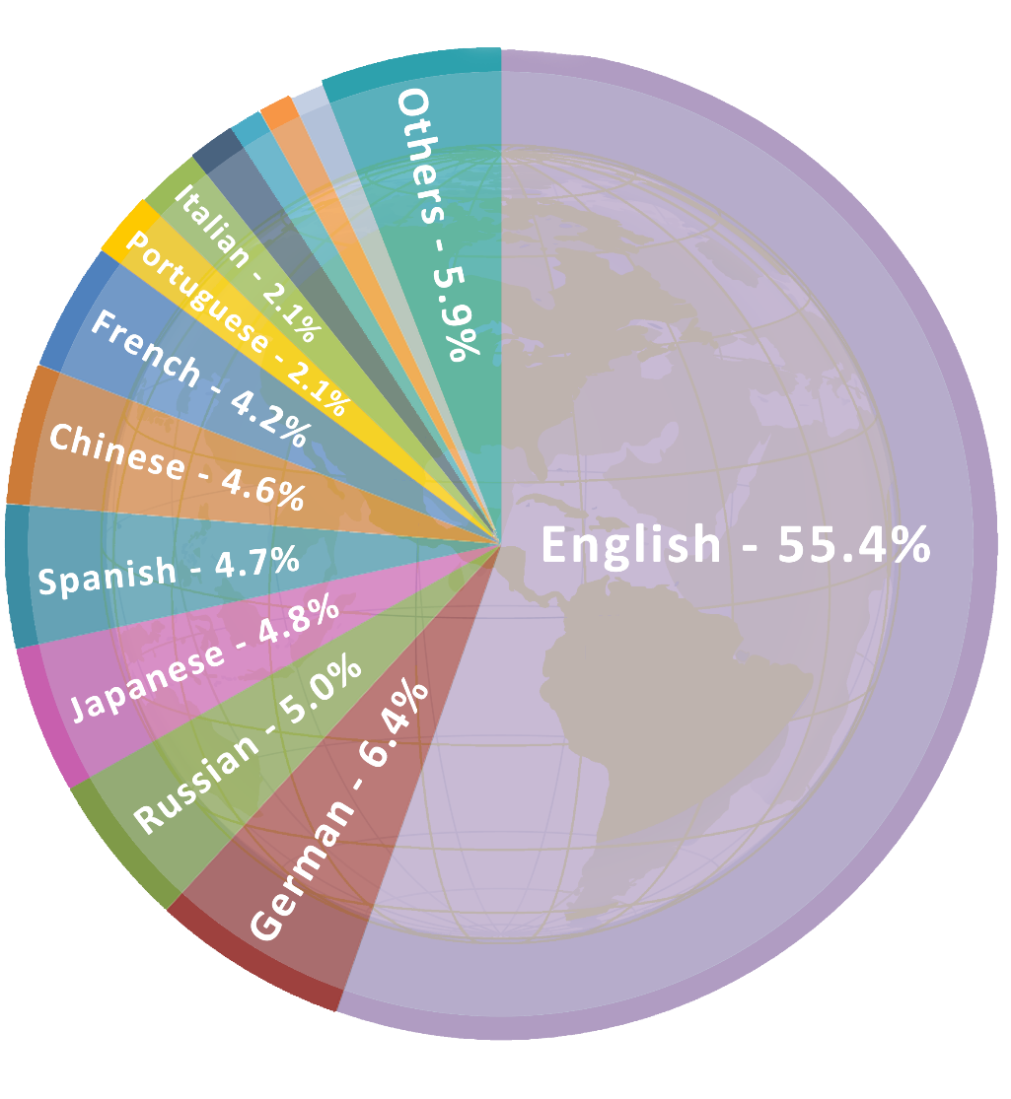
Why English?
Communication and information are crucial in a society
Nowadays internet is the main source of information
Thanks to Internet, the education process has
changed significantly
Content in internet : 55% in the English language
[2]
[2] "Usage of content languages for websites". W3Techs.com. Retrieved 25 August 2013.

Slide 12
CONTENTS
Introduction
Why Hearing Impaired People?
Why Albanian Sign Language?
Why English?
Application
Reception
For the future
Conclusions

Slide 13
Application
Platform, development tools and technologies
Windows 8 WinRT Application Platform.
To be used also on touch-capable devices, but not only.
Microsoft Azure Cloud Storage
Visual Studio 2012
Concept
English to Albanian Sign Language Dictionary
English Language Learning Method
Consultancy
ANAD (Albanian National Association of the Deaf), Pedagogical Specialists
Department of Informatics: Prof.As.Dr. Elinda Kajo Meçe

Slide 15
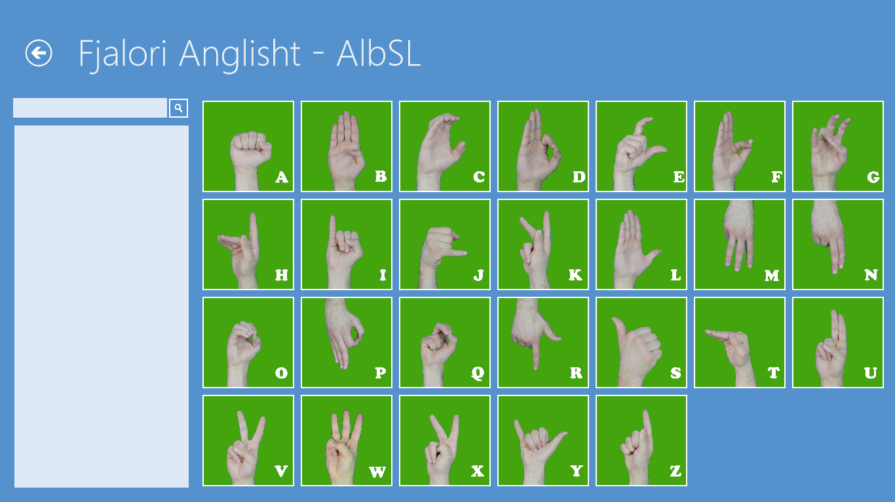

Slide 19
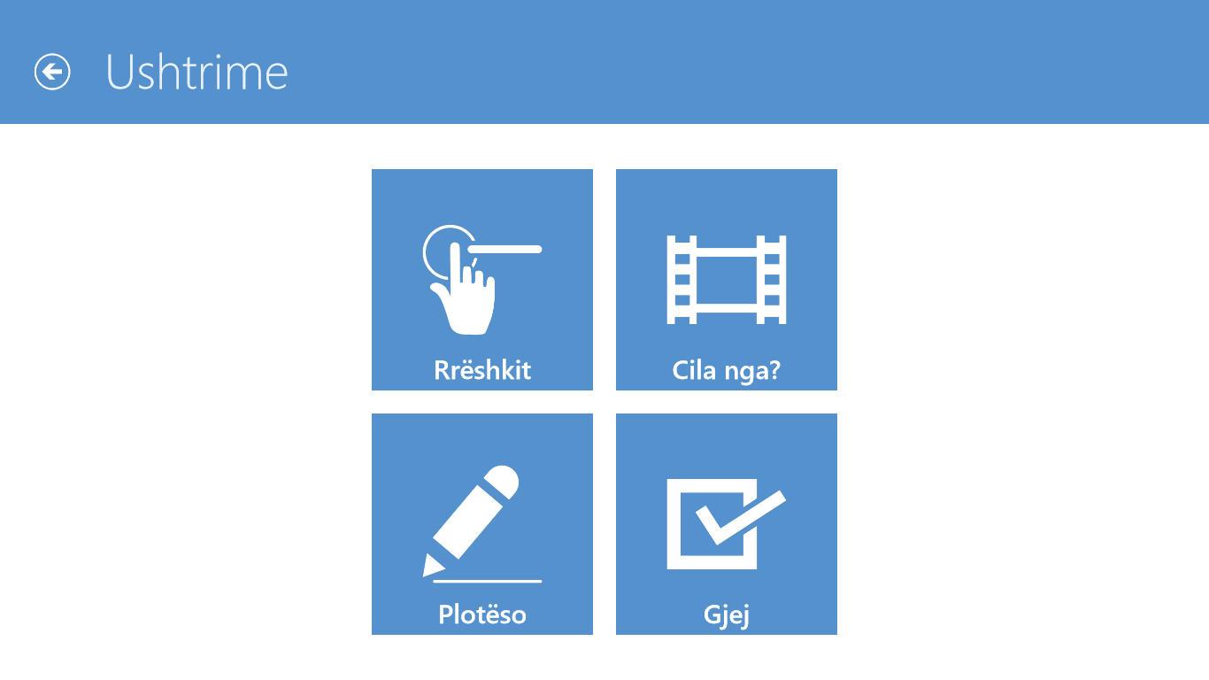

Slide 20
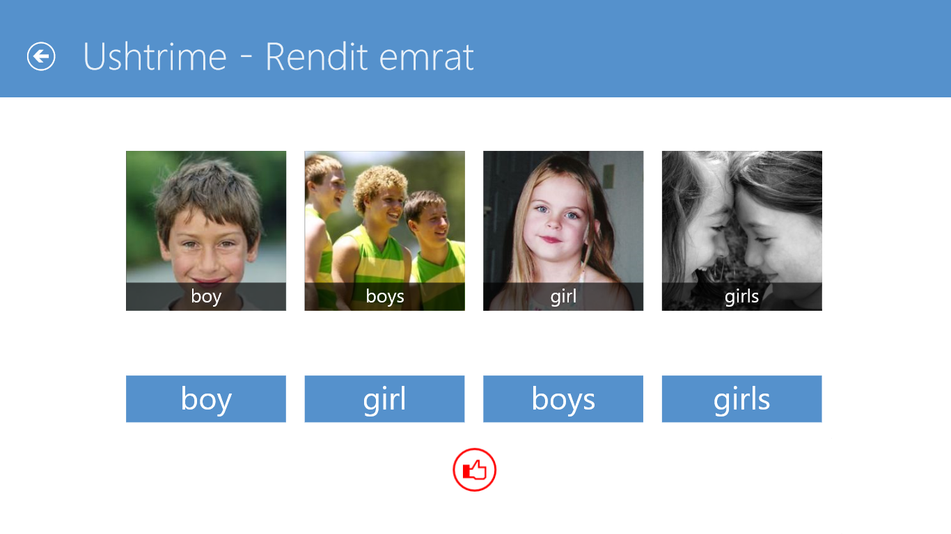

Slide 22
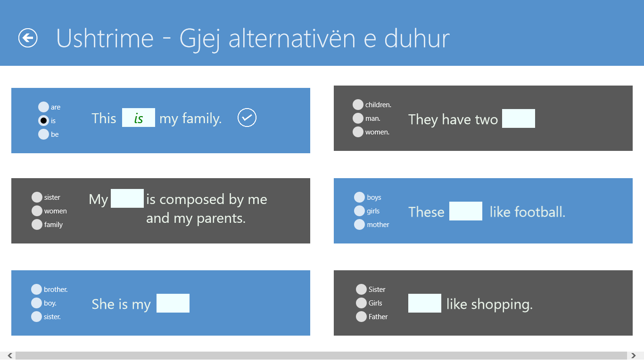

Slide 23
CONTENTS
Introduction
Why Hearing Impaired People?
Why Albanian Sign Language?
Why English?
Application
Reception
For the future
Conclusions

Slide 24
Reception
Winner of Microsoft’s Imagine Cup 2013 National Contest
2013 Albanian ICT Awards – ICT Creativity of the Year Nominee
Very well accepted by the Albanian National Association for the Deaf – further collaborative development is on schedule
Well accepted from the only public school for deaf and hearing impaired people in Tirana

Slide 25
CONTENTS
Introduction
Why Hearing Impaired People?
Why Albanian Sign Language?
Why English?
Application
Reception
For the future
Conclusions

Slide 26
For the future
Refinement of current version , database population
New module: Albanian Sign Language to Written English
Gesture interpretation: Microsoft Kinect
Possibility to migrate to Open Source technologies
Decrease development costs at minimum

Slide 27
CONTENTS
Introduction
Why Hearing Impaired People?
Why Albanian Sign Language?
Why English?
Application
Reception
For the future
Conclusions

Slide 28
Conclusions
Hearing Impaired community:
Language learning in traditional methods is hardly productive
Developed a more appropriate solution
Result was satisfactory
Developing team:
Enrich our programming abilities
Improve team-work experience
Joy and satisfaction to receive positive feedback from the HI community

Slide 29
Thank you!
Questions?

